Slide 1

[Pin Reference] Cases
Bob Ross, Teraspeed Labs bob@teraspeedlabs.com
ATM Meeting
May 3, 2016

Slide 2
Some Reference Examples
“Dominant” reference based on internal circuit or known specification (PECL, Open Drain??)
Some measurement references with different externally applied voltages should be a function of two rails

Slide 3
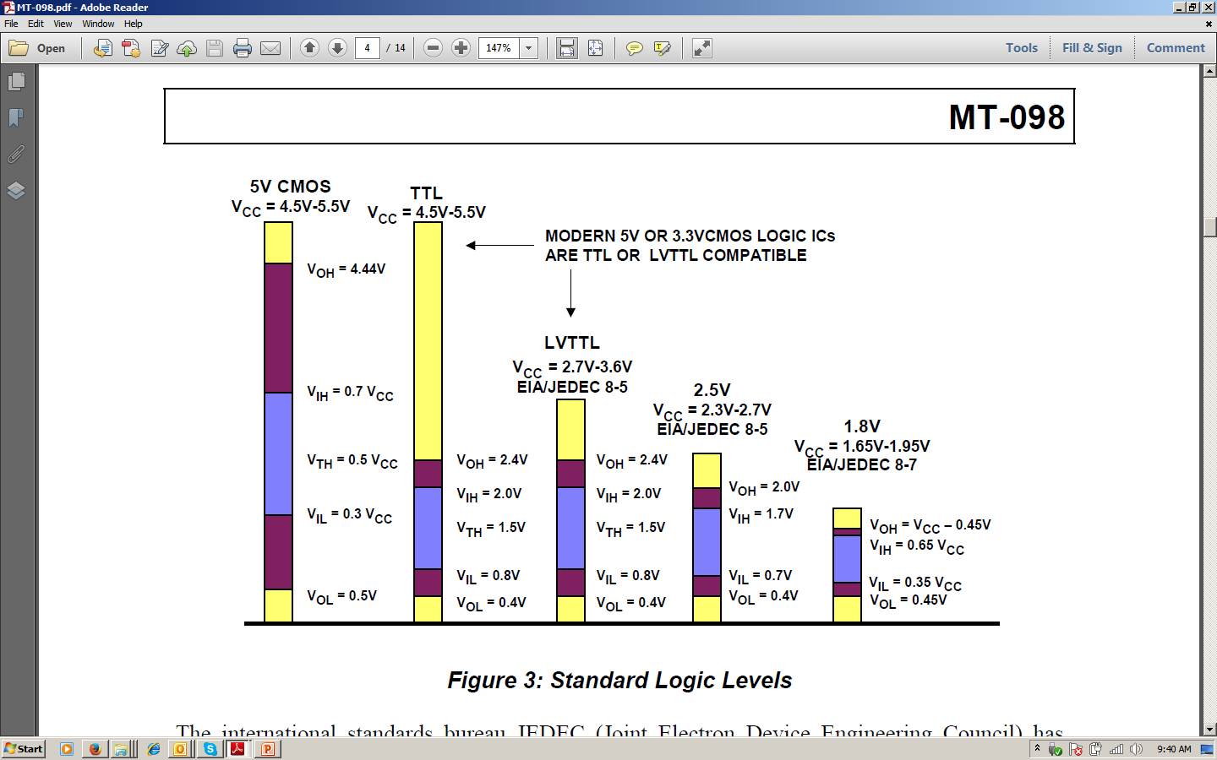
CMOS and TTL Thresholds
Analog Devices MT-098 Tutorial

Slide 4
CMOS and TTL Thresholds
CMOS thresholds references a function of both rails, TTL thresholds a function of the negative rail

Slide 5
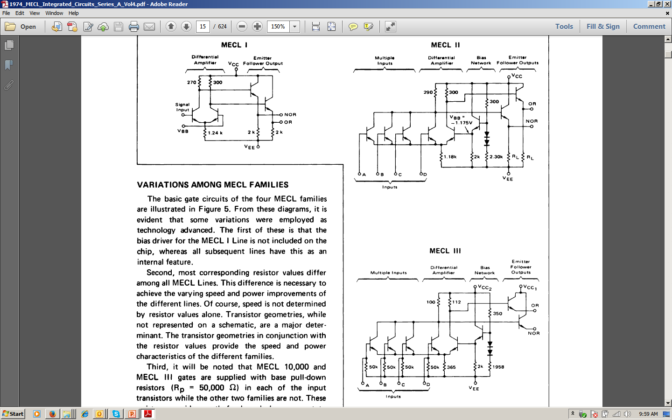
PECL/ECL Thresholds
1974 MECL Integrated Circuits Series A (Motorola)

Slide 6
PECL/ECL Thresholds
300 Ω to 2.30 k divider shows Vcc dominates thresholds

